Slide 1
Introduction to Graphical User Interfaces

Slide 2
Objectives
* Students should understand what a procedural program is.
* Students should understand what an event driven program is.
* Students should understand how to design event driven programs.

Slide 3
A Simple View of a Procedural Program
static class Program
{
int Main ( )
{
declare variables
get console input
do application work
. . .
output to the console
. . .
return 0;
}
}

Slide 4
A Simple View of a Procedural Program
static class Program
{
int Main ( )
{
declare variables
get console input
do application work
. . .
output to the console
. . .
return 0;
}
}
The code you
write in Main
is in charge.
Execution flows from top to
bottom.

Slide 5
Event Driven Model
Form
Object
Application
Object
Domain
Objects

Slide 6
Event Driven Model
Application
Object
The application object “listens”
for events to occur, then calls
event handlers in the Form
object. You write these event handlers.
With Visual Studio we never have
to worry about writing code for the
application object. It is done for us.

Slide 7
Graphical User Interface Model
A Button
Form
Object
A Menu Item
Event handlers react
to events
A ListBox
GUI Components
generate events.

Slide 8
GUI Components
x
File Edit View Help
Name:
Phone:
Form
PUSH

Slide 9
Event Driven Model
Domain objects do the work of
the application. An example of a
domain object would be an Employee
object in a payroll application.
Domain
Objects

Slide 10
File Edit View Help
Application
Object
Button
Event
PUSH
Windows
Event Queue

Slide 11
Form
Object
Application
Object
Button
Event
Windows
Event Queue

Slide 12
Form
Object
Application
Object
Call event handler
Button
Event
Windows
Event Queue

Slide 13
Graphical User Interfaces
Form
Object
Application
Object
Call event handler
Button
Event
Call functions in
domain objects
to do some work.
Domain
Objects
Windows
Event Queue

Slide 14
Creating a Simple GUI Program
Start Visual Studio.
Select New Project

Slide 15
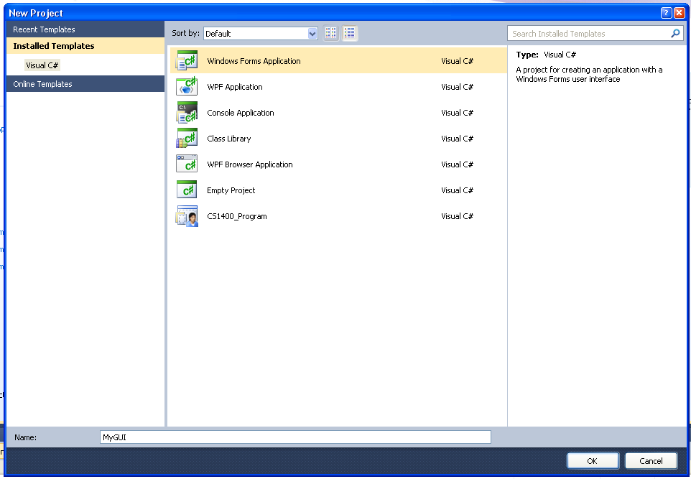
Select Windows Form Application

Slide 16
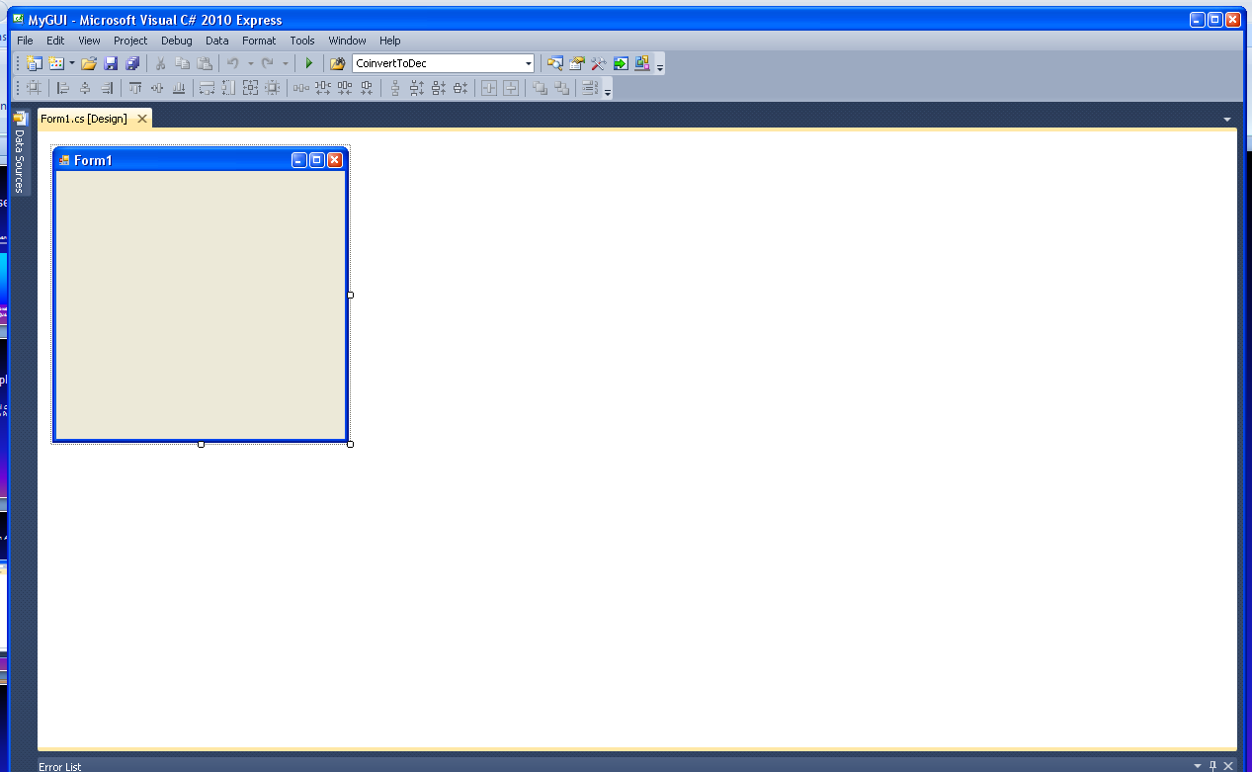
You should see the Form Design Page

Slide 17
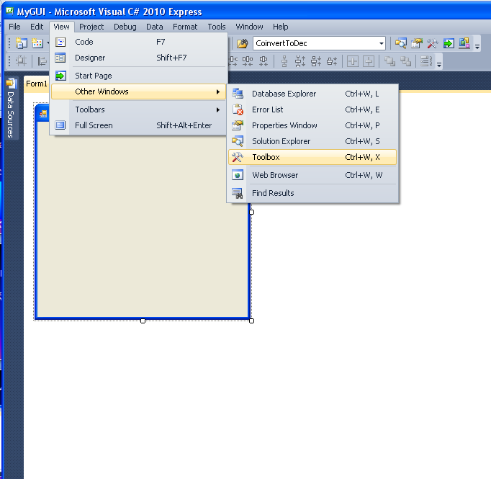
We want to add some GUI components to the Form.
Click on View->Other Windows->Toolbox.

Slide 18
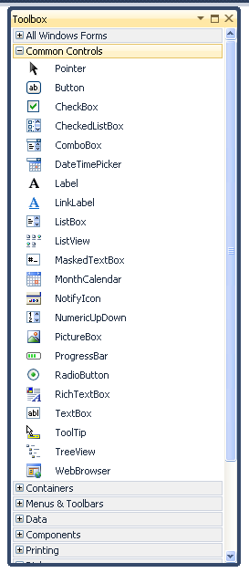
The toolbox lists all of the
available GUI components,
organized into categories. If
they are not visible, click the +
button on the Common Controls
line .

Slide 19
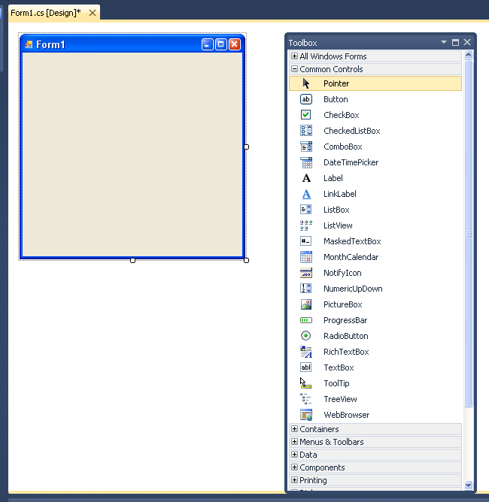
ab
Move the cursor over the
Button symbol in the toolbox.
Press and hold the left mouse
button and drag a Button onto
the Form.
button1

Slide 20
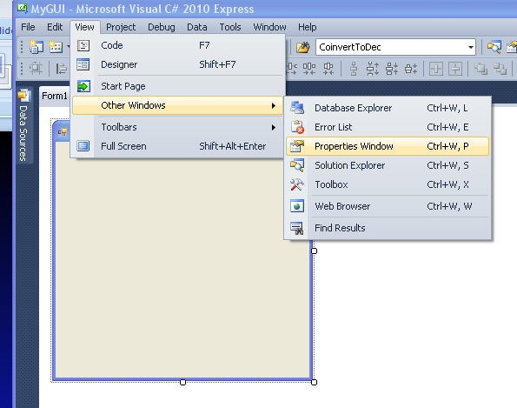
We want to be able to see
and modify the properties
of this button.
Click on View->OtherWindows
->Properties Window to open
the Properties window.

Slide 21
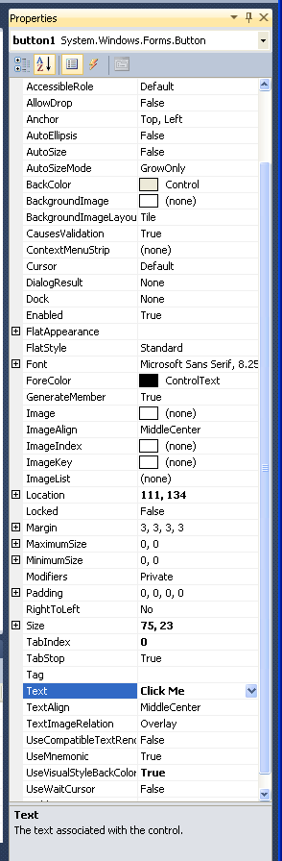
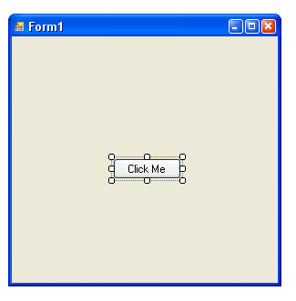
Here you can see and change
various properties of the
current button object on the
form.
I have changed the text on
the button to “Click Me”

Slide 22
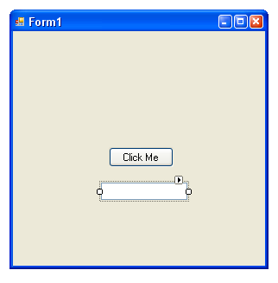
Now drag a TextBox from the
toolbox onto the form. Position
it just beneath the Button object.
In the Properties window notice
that the TextBox has a property
named Text. This is the text that
appears in the box. Leave this
blank for now.

Slide 23
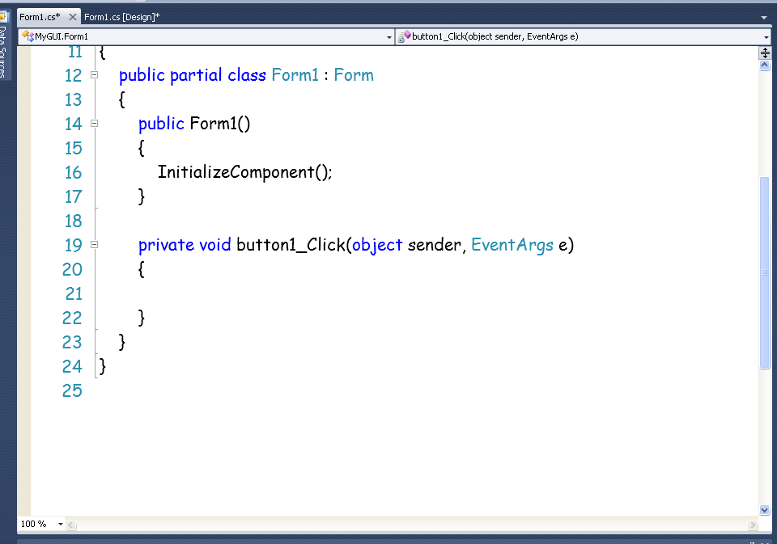
Now let’s create an event handler for the Button
object. To do this, double click on the Button. You
should see a code window like this open up:

Slide 24
Caution: Do NOT double click on GUI
components that you do not want to
write an event handler for.
If you do this by mistake, don’t try
to delete the code that Visual Studio
generates.

Slide 25
Don’t change any of the code that you see.

Slide 26
We will add code between the curly braces
in the button1_Click method. This code will
be executed whenever the button is clicked on.

Slide 27
Let’s change the Text property of the TextBox to
something like “Ouch!”.

Slide 28
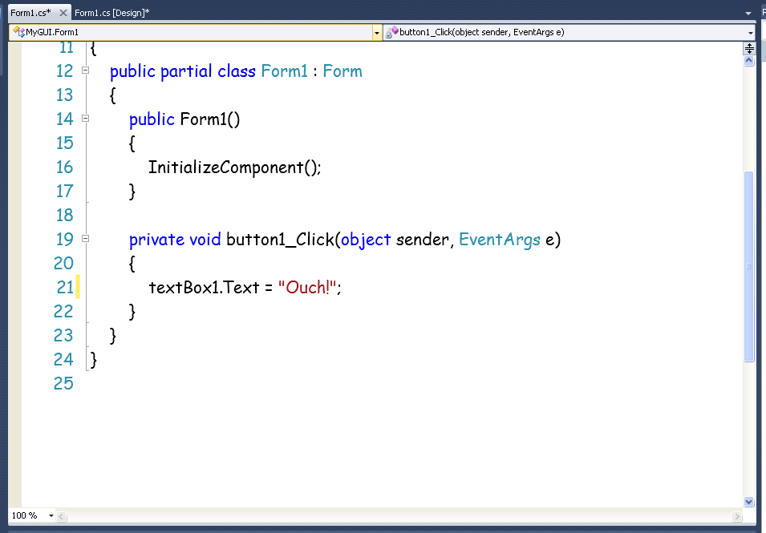

Slide 29
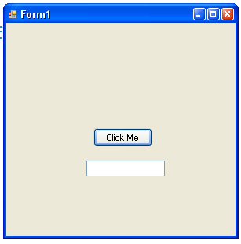
Build and run the program. It should look
something like this. Now click on the Button.

Slide 30
